Slide 1
Using Git
Diari Shareef

Slide 2

What is Git?
Think of it as a filing system for every draft of a document.
Git, like other version control systems, manages and stores revisions of projects.
Github allows you to take part in collaboration by forking projects, sending and pulling requests, and monitoring development.
It also provides access control and several collaboration features, such as a wikis and basic task management tools for every project.

Slide 3
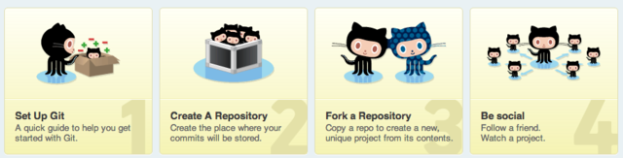
Git Workflow

Slide 4
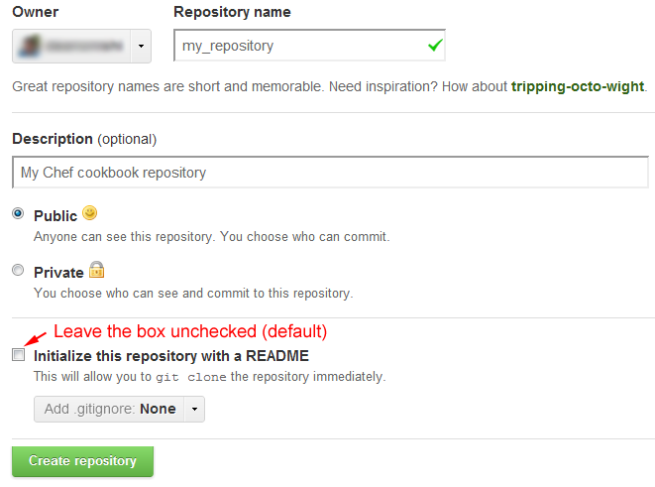
Create A Repository

Slide 5
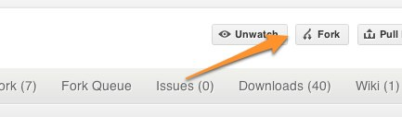
Forking a Repository
At some point you may find yourself wanting to contribute to someone else's project, or would like to use someone's project as the starting point for your own. This is known as "forking.
This enables you to take a project that you don’t have write access to and modify it under your own account.

Slide 6
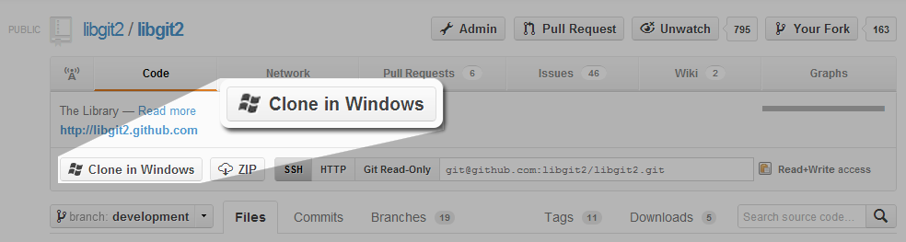
Clone a Repository
You've successfully forked the repository, but so far it only exists on GitHub. To be able to work on the project, you will need to clone it to your local machine.

Slide 7
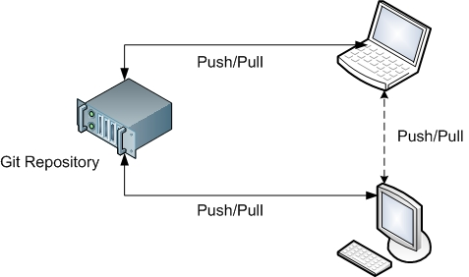
Push Commits
Once you've made some commits to a forked repository and want to push it to your forked project, you do it the same way you would with a regular repository.

Slide 8
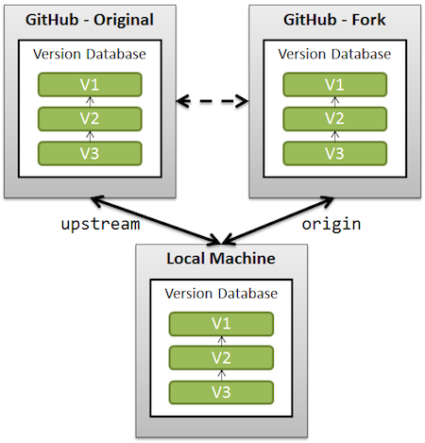
Fetch Upstream
If the original repository you forked your project from gets updated, you can add those updates to your fork

Slide 9
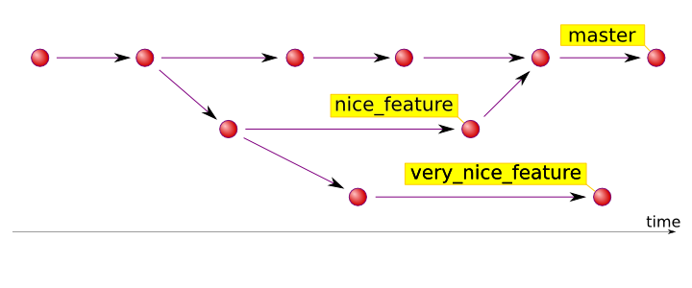
Branching
Branching allows you to build new features or test out ideas without putting your main project at risk. In git, branch is a sort of bookmark that references the last commit made in the branch. This makes branches very small and easy to work with.

Slide 10
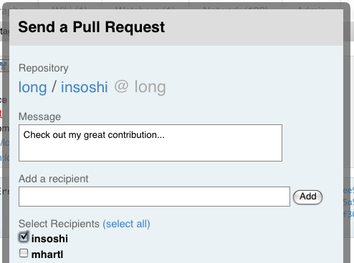
Pull Requests
If you make changes you’d like to share, you can send a notification called a “pull request” to the original owner. That user can then, with a click of a button, merge the changes found in your repo with the original repo.

Slide 11
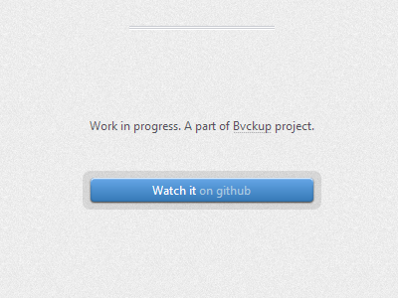
Be Social
One of the features of GitHub is the ability to see what other people are working on. When you follow someone or watch a project, you will get notifications on your dashboard about their GitHub activity.

Slide 12
Pros
Cons
Proven and widely used
Collaborative Environment
Sharing code makes you think about documenting code
Learning Curve
Costs money if Enterprise licence not already available

Slide 13

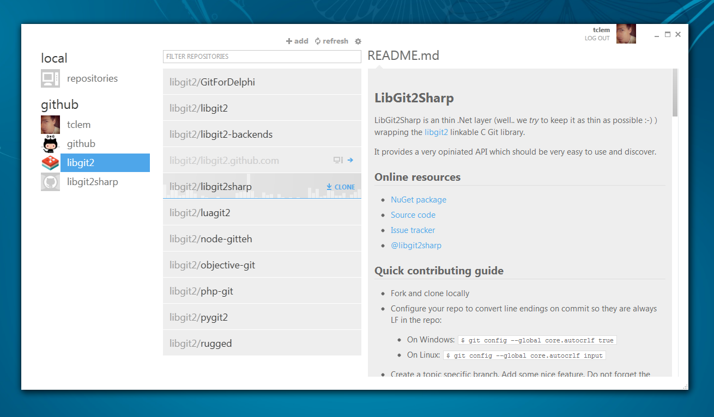
Try Git
Got 15 minutes and want to learn Git?
Set Up Git:
Mac Windows Linux
http://try.github.io/levels/1/challenges/1
https://help.github.com/articles/set-up-git

Slide 14
Find These Slides
https://github.com/Diari

